Slide 1
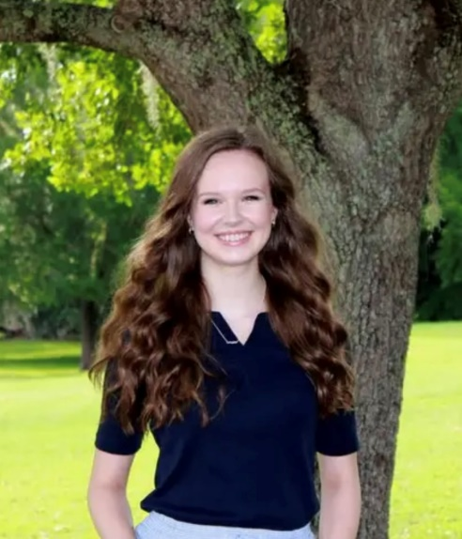
The Basics!
My name is Paige Centers and I am so excited to be your fifth grade Language Arts and Social Studies teacher! I graduated magna cum laude from Florida State University, with my bachelor’s degree in Social Science Education. This will be my third year teaching fifth grade here at Conley and my fifth year teaching elementary school here in Tallahassee. I am Reading and ESOL endorsed by the Florida Department of Education.
Ms.
Centers
I am very passionate about helping students succeed and love watching them achieve their full potential. In my free time, I love crocheting, traveling, spending time outside, hanging out with family, and reading!
Contact me!
My Favorites!
Food: Pizza
Flower: Sunflowers
Movie: The Emperor’s New Groove Book: “Jane Eyre” by Charlotte Bronte Color: Green
Drink: Matcha
Subject: History
Store: Target or Amazon
Email: centersp@leonschools.net
Email is the best way to reach me, as it is difficult to take unscheduled phone calls throughout the school day. I do my best to respond promptly within 24 hours.
I can be reached Monday-Friday, from 8:00 am-4:00 pm

